Slide 1
A Federated Learning approach for text classification using NLP

Slide 2
Introduction
Federated Learning approach
Text classification

Slide 3
Dataset and Data Pre-processing
21450 data points of multi-class emotions.
The dataset has a number of different categories of emotions, ranging from happy to sadness, to love and fear.
Eliminated emoji symbols.
Eliminated URLs.
Removed unnecessary punctuations.
Applied Tokenizaion.
Divided dataset into Training (88%) and testing (12%).

Slide 4
Bidirectional LSTM
BI-LSTM is usually employed where the sequence to sequence tasks are needed.
Upgraded version of traditional LSTM.
Bi-LSTM based modelling offers better prediction than regular LSTM.
The accuracy can be improved with increasing quantities of training data and training epochs.
We got 89% of accuracy using Bi-LSTM into our dataset.

Slide 5
Deep Learning Technique
Categorizing views from all over the world through social media on Healthcare
To asses the categorizing performance, accuracy of the algorithms employed in DL is used
Deep learning combined with NLP offers great potential in text classification challenges
LSTM technology also offers great improvement in solving problems

Slide 6
CNN
Model with Embedded layer and first 2nd layer is Convolutional layer.
ConV1D
Result of our classification report and confusion matrix.

Slide 7
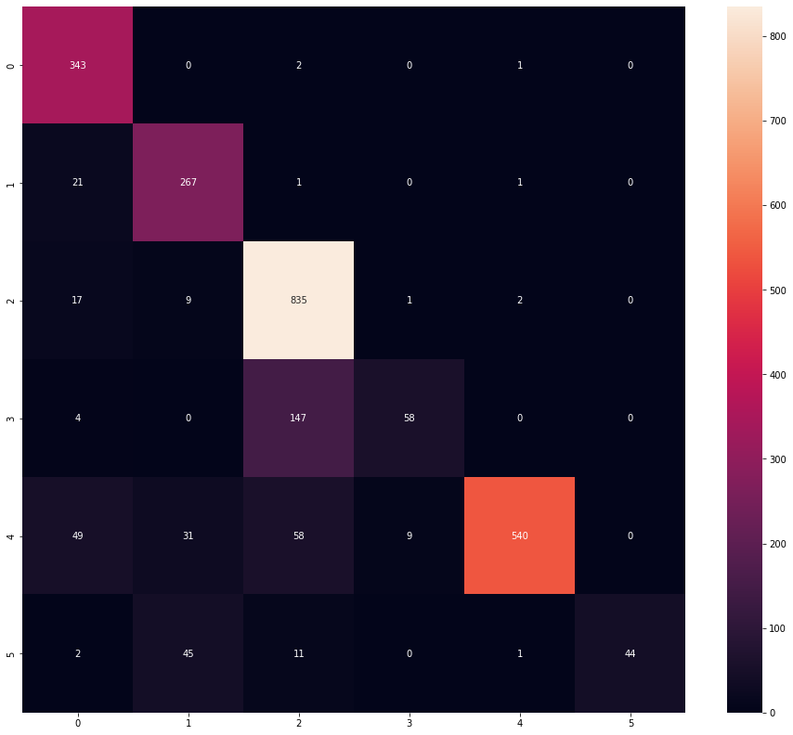
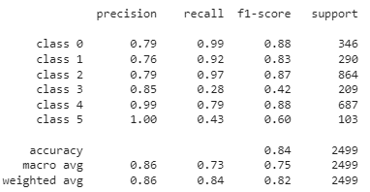
Classification Report & Confusion Matrix

Slide 8
Activision Fucntion
ReLu
Sigmoid
Adam
DropOut
Regularizer
GlobalMaxPooling

Slide 9
GRU
Uses gates to control the flow of information
Relatively new
Takes relatively less memory and faster than LSTM
92% Accuracy
Classification report & Confusion matrix

Slide 10
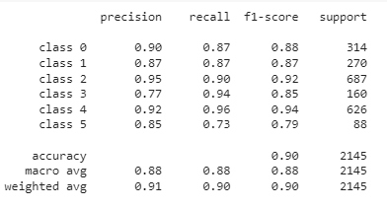
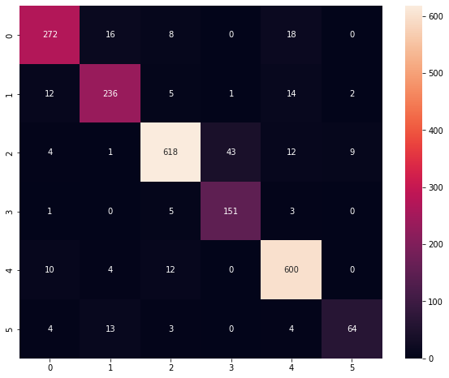
Classification Report and Confusion Matrix

Slide 11
Results
The solution for a better accuracy in federated settings could be to increase the dataset and increasing the federated rounds without changing the model architectures.

Slide 12
Conclusion
Performance of such a model is dependent on a number of aspects, including the quality of data and parameters.
Dataset suppliers should also update their databases as soon as new data becomes available in order to augment models through communication loops.

